Slide 1
OrderHub – Food Ordering Management System
Group 18
Priya Babulal Soni(002831438)
Ashwin Nair(002647626)
Vaibhavee Kanalal Gamit(002821886)
Ajith B(002820843)
Channaveera(002825263)
Project for DAMG6210 – Data Management and Database Design
Under the guidance of Manuel D Montrond

Slide 2
OVERVIEW
The objective of the OrderHub - Food Ordering Management System is to effectively manage
the food delivery system. Data about customers, customer orders, menus, deliveries, and order
reviews are all gathered and managed by it. The system uses real-time analytics to support
decision-making. This aims to streamline processes, enhance customer service, and facilitate
decision-making for restaurant management, leading to increased productivity, cost
effectiveness, and customer satisfaction. Ensure that the database's security and integrity are
protected.

Slide 3
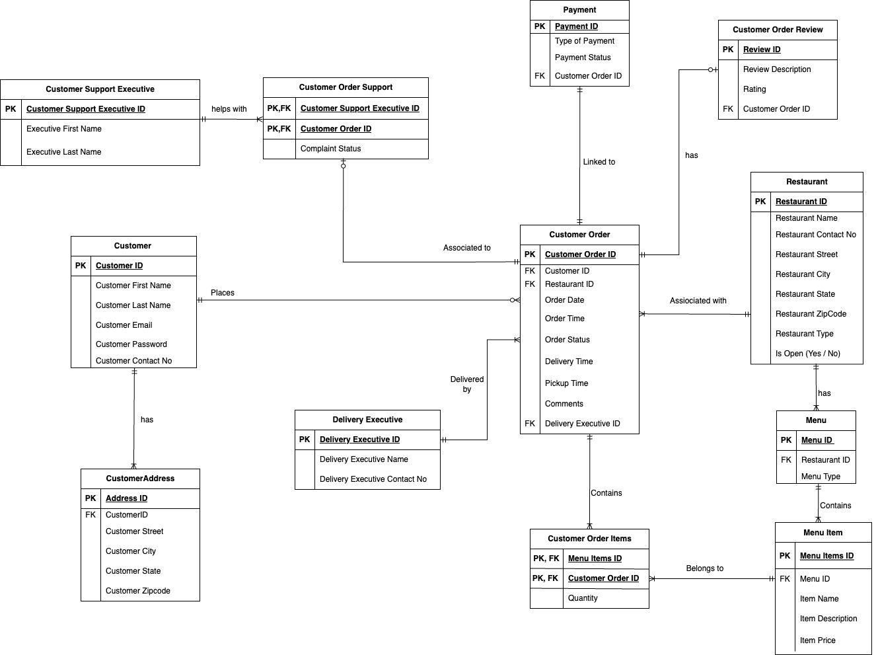
FINAL E-R DIAGRAM

Slide 4
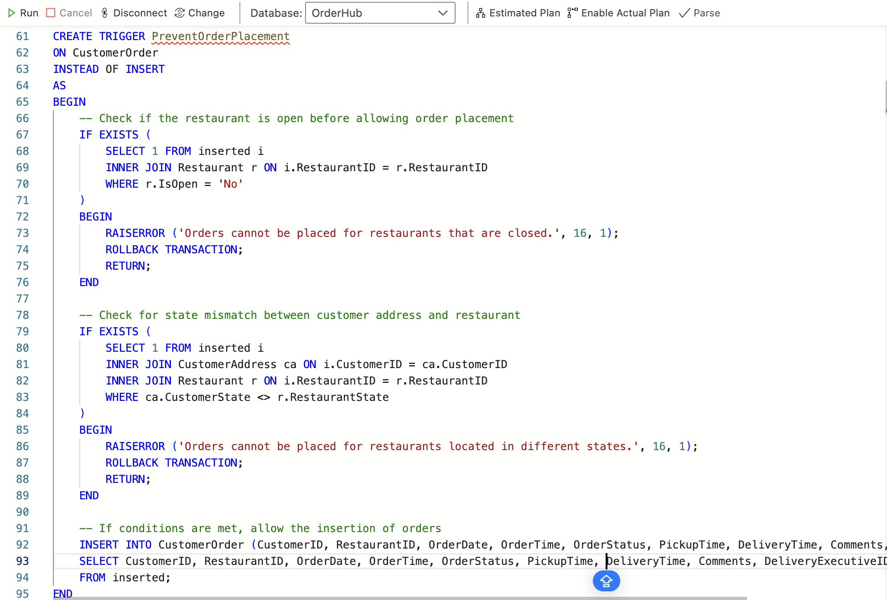
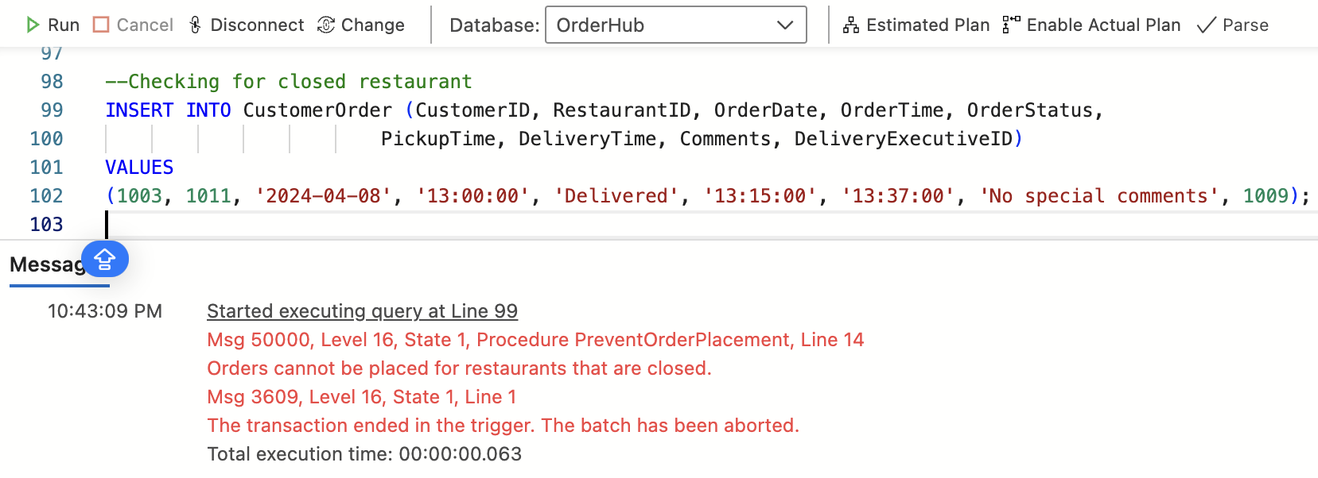
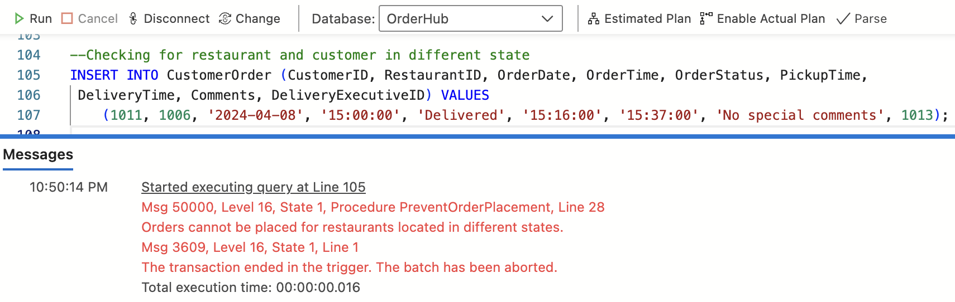
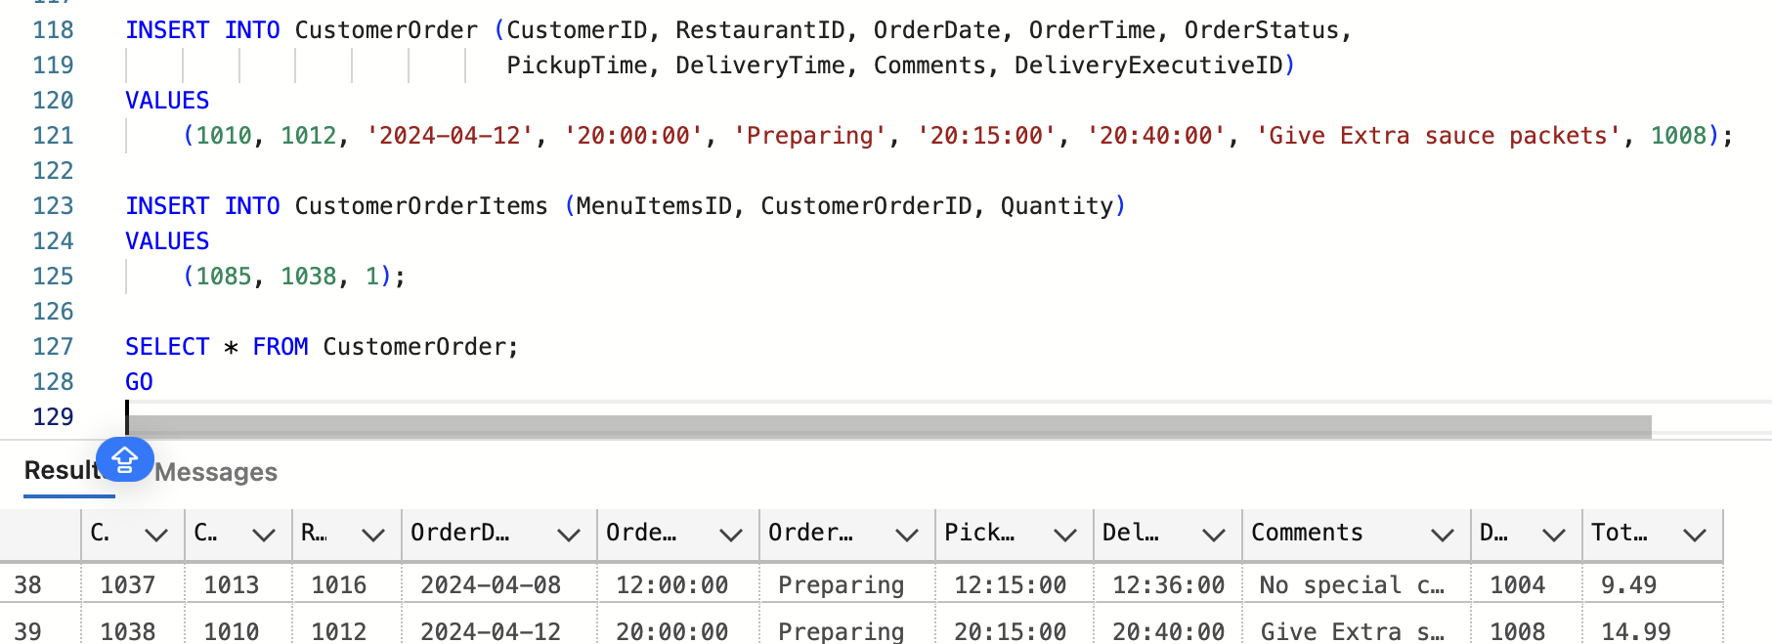
TRIGGERS

Slide 5
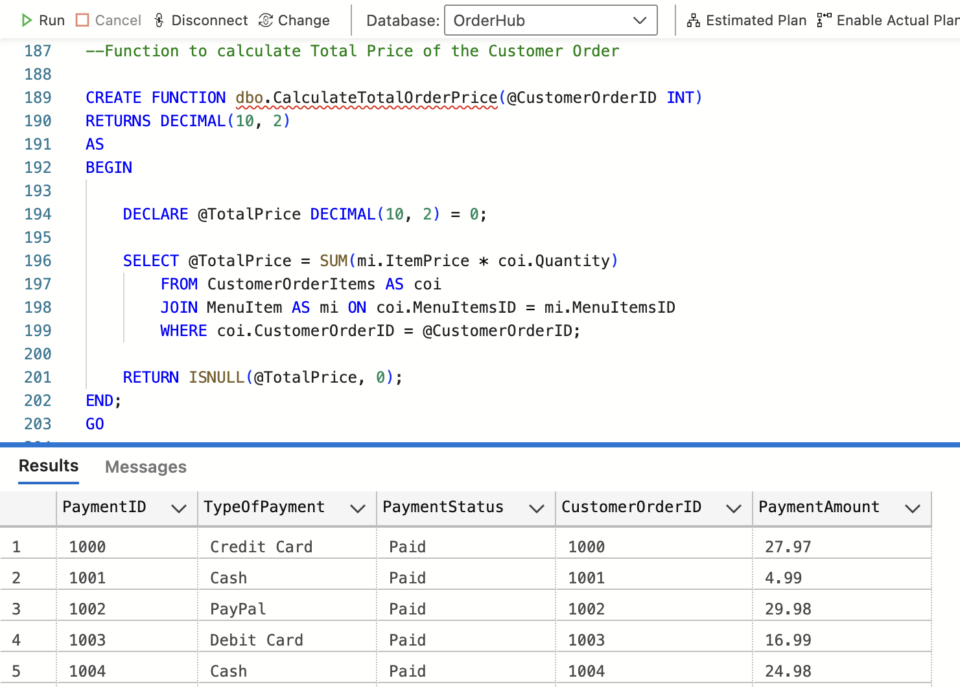
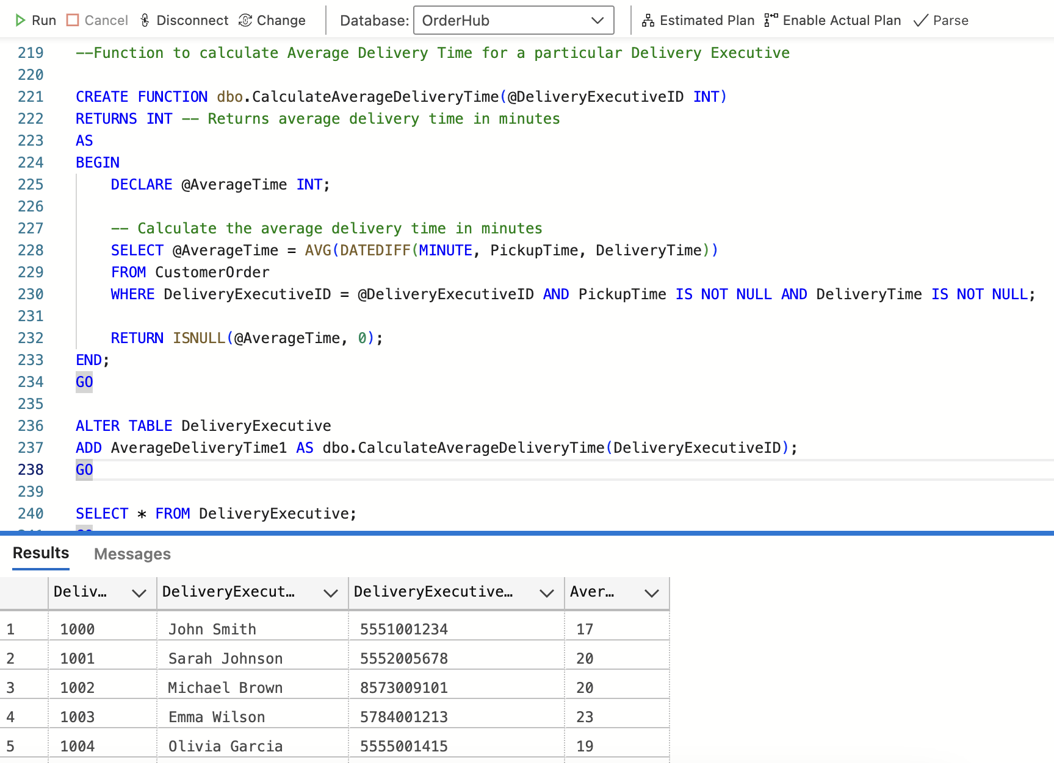
FUNCTIONS
Function 1
Function 2

Slide 6
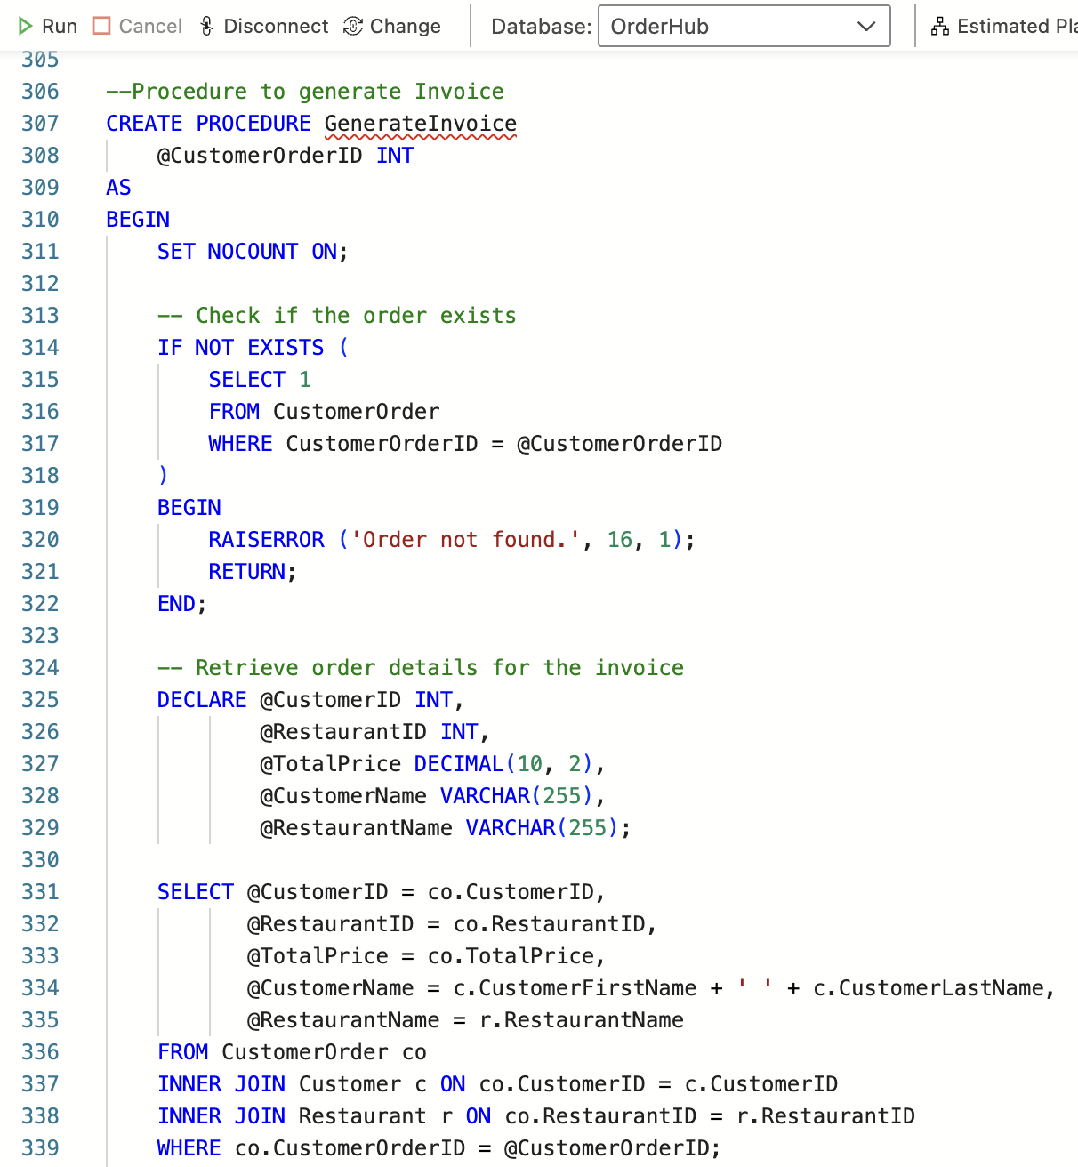
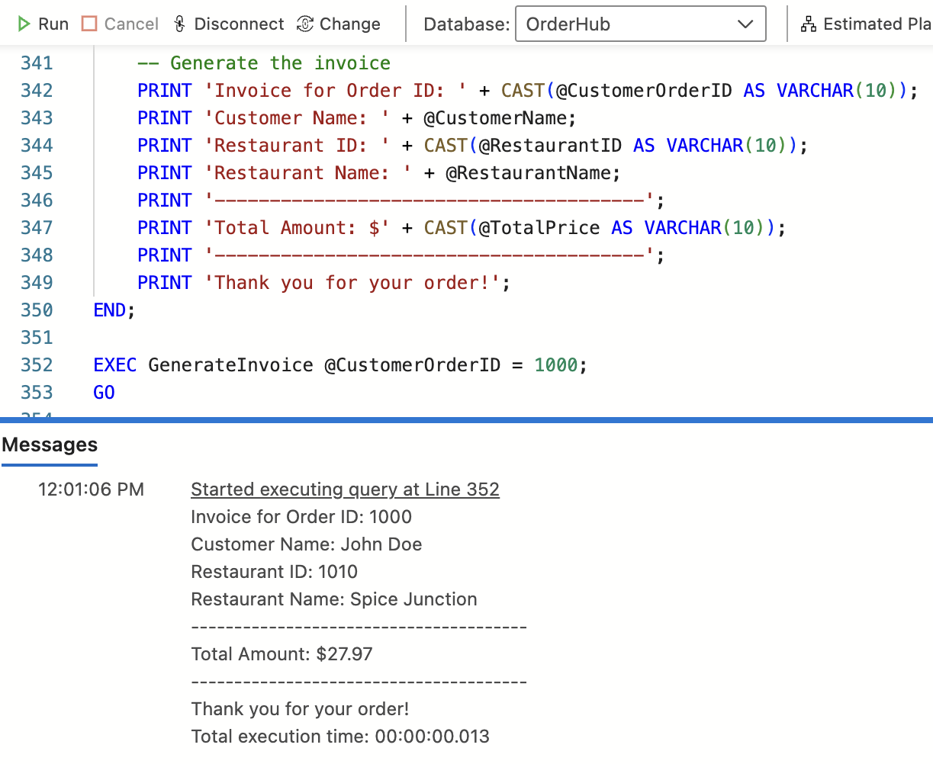
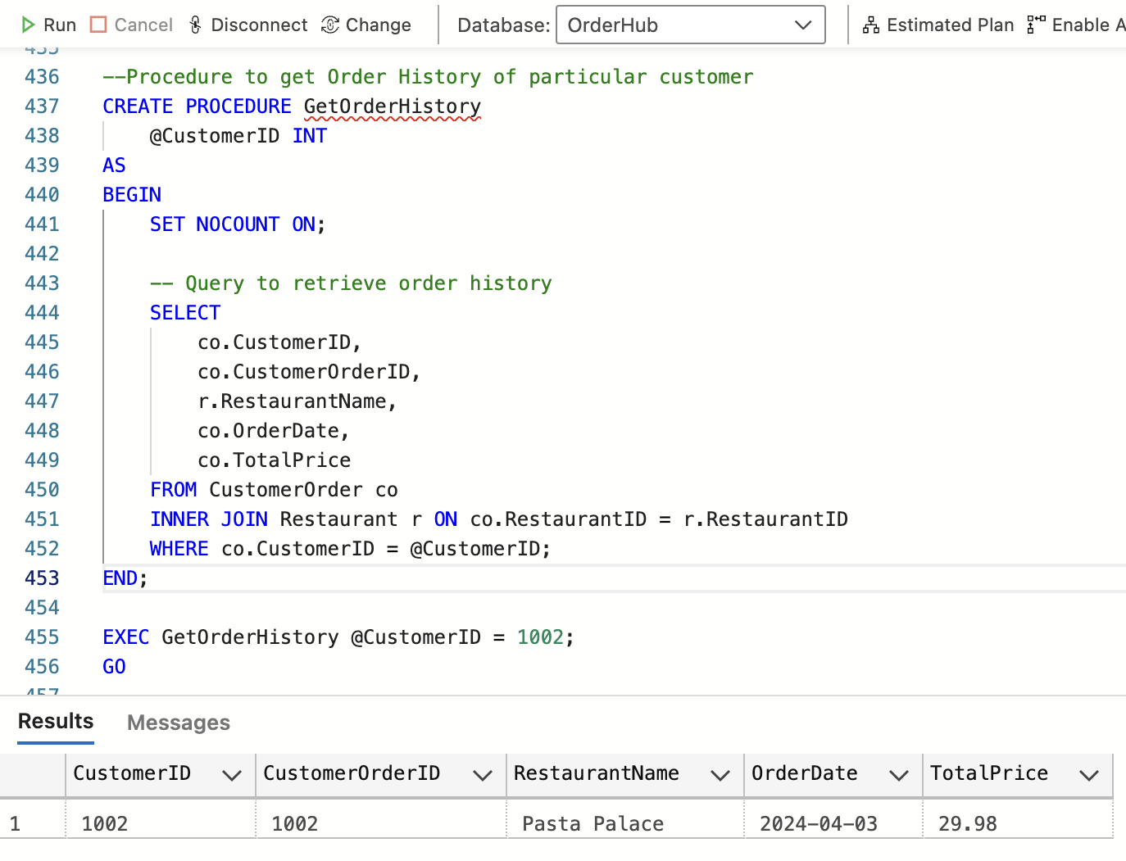
PROCEDURES
Procedure 1
Procedure 2

Slide 7
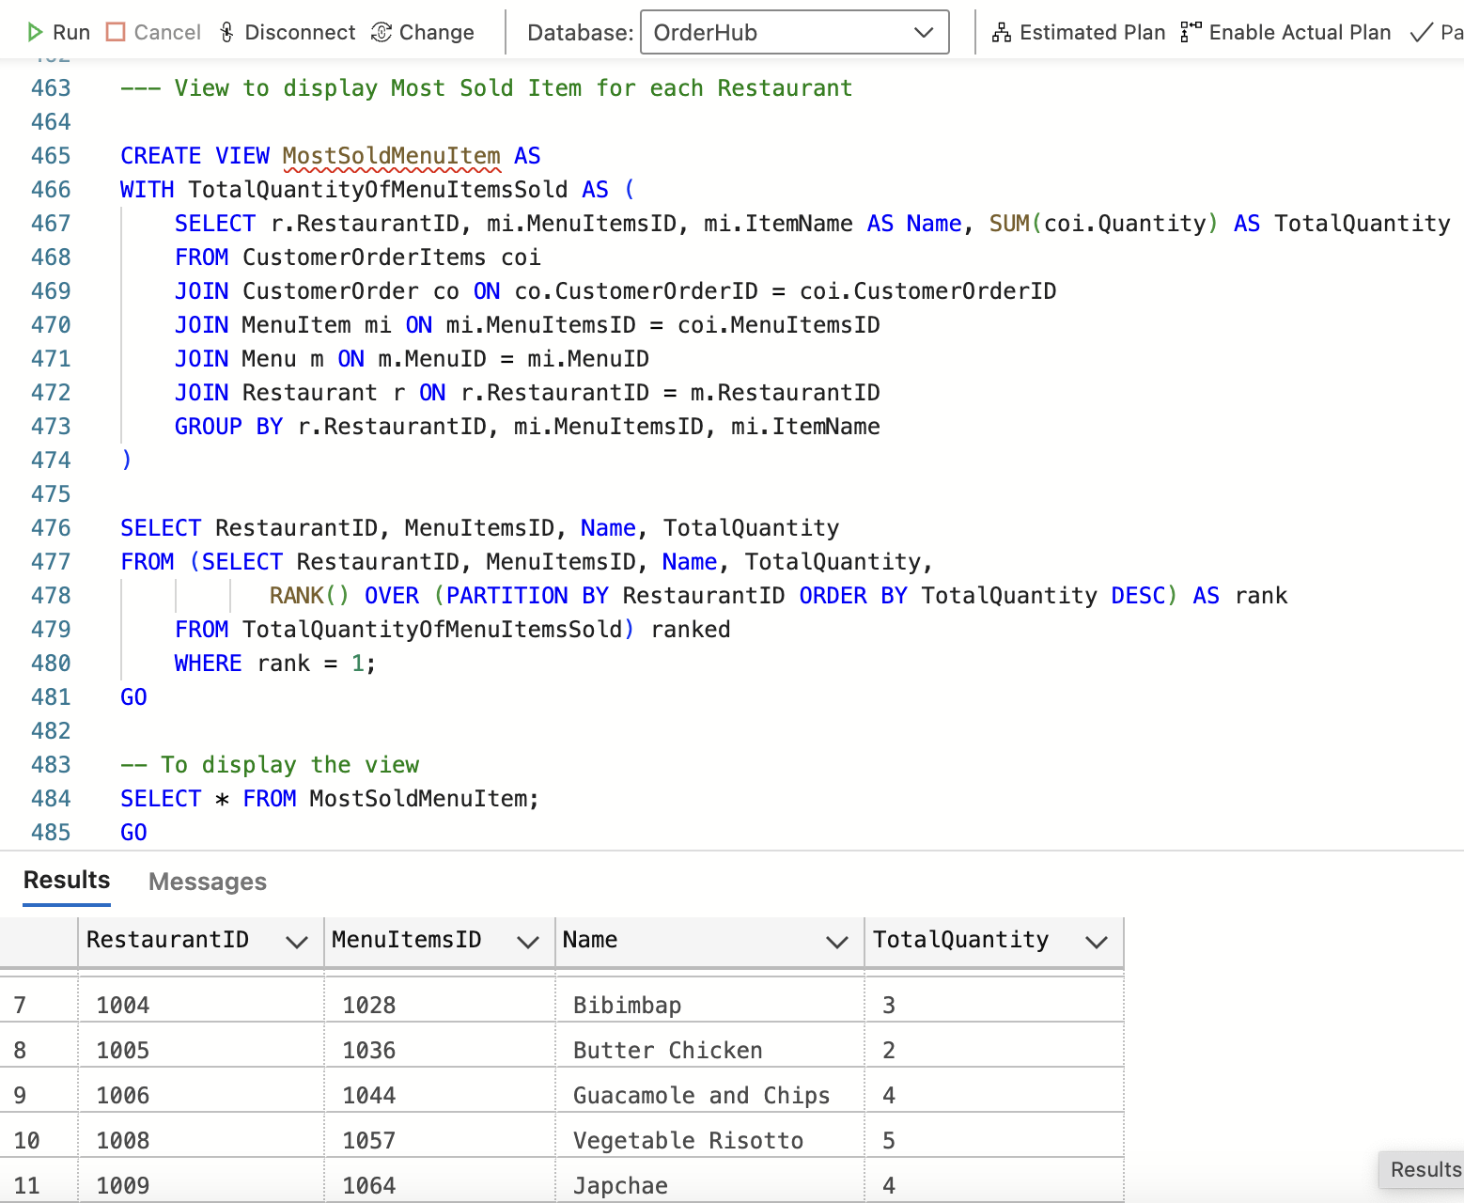
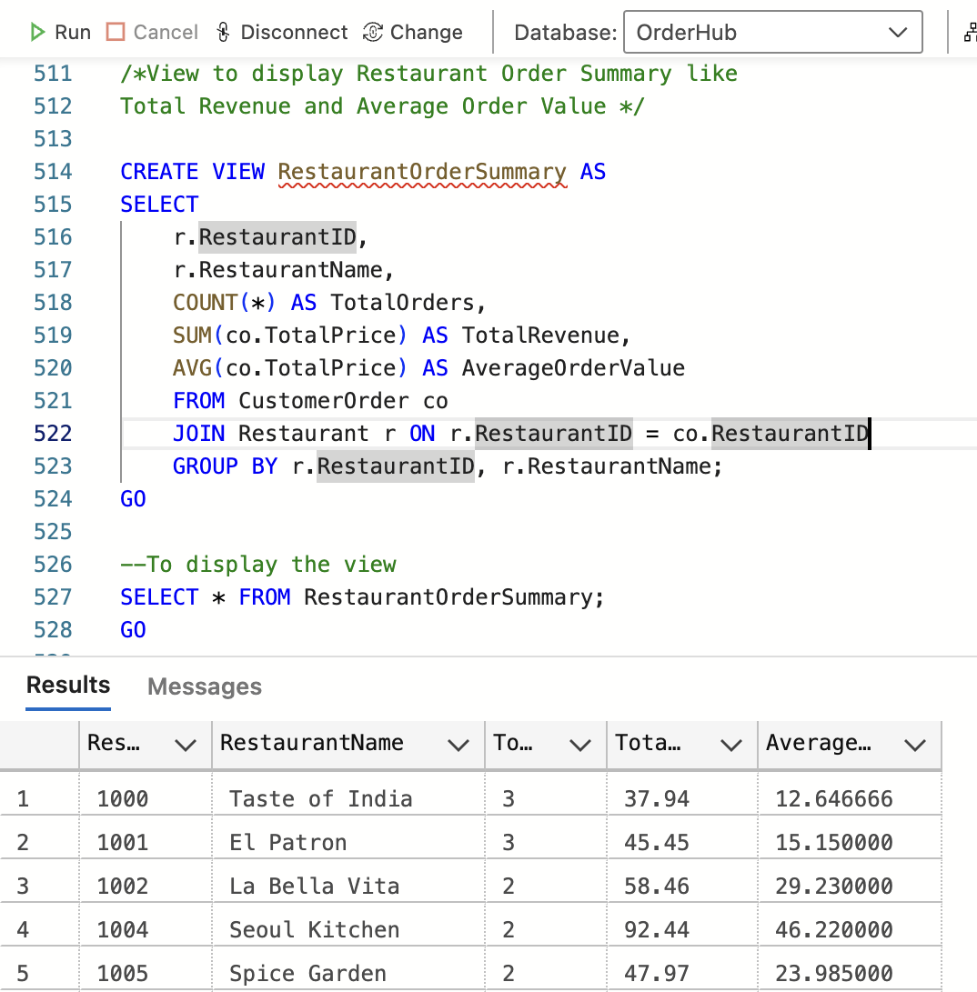
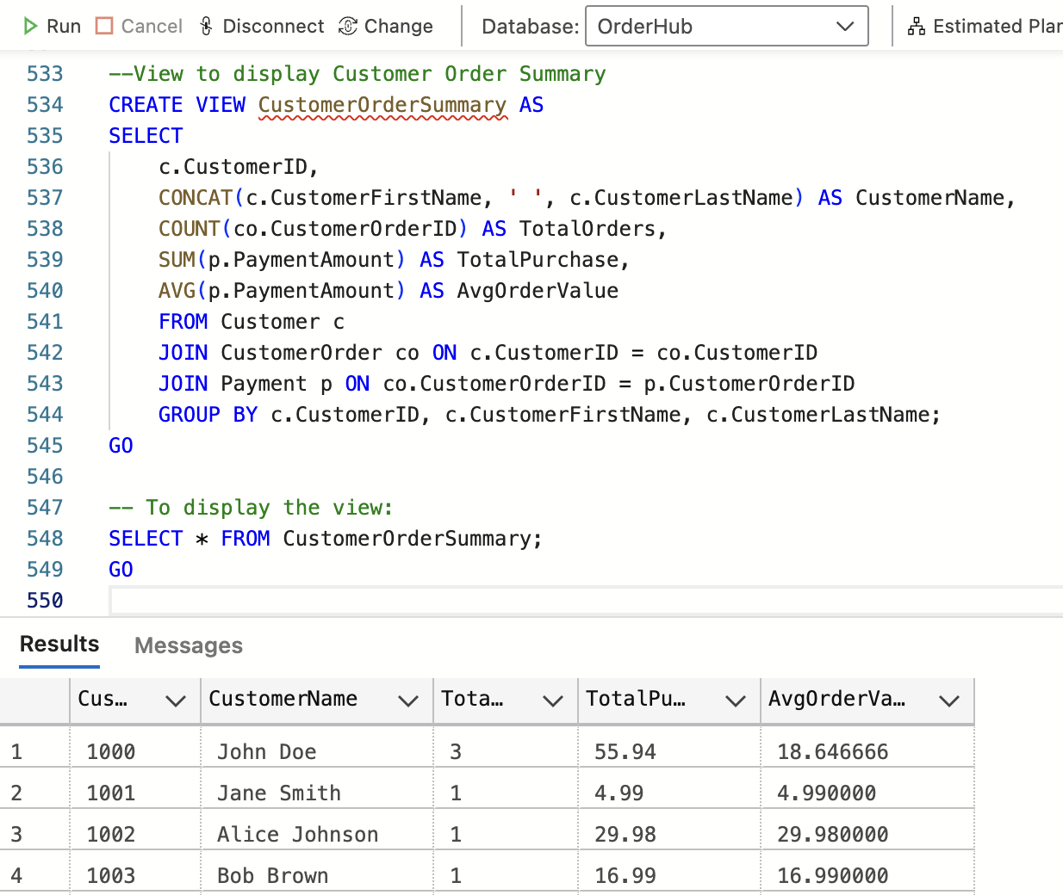
VIEWS
View 1
View 2
View 3

Slide 8
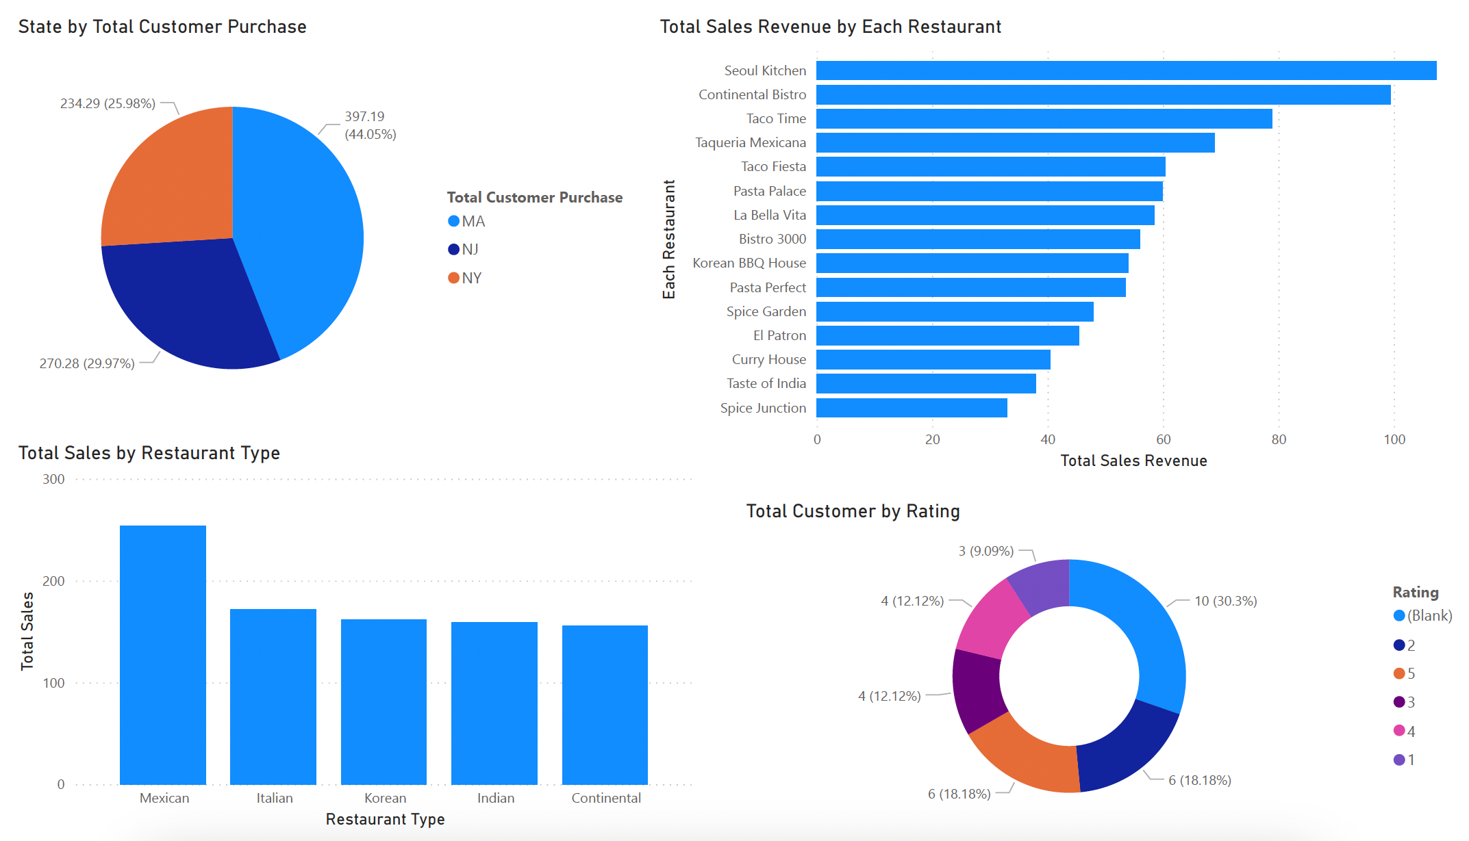
VISUALIZATIONS

